Slide 1
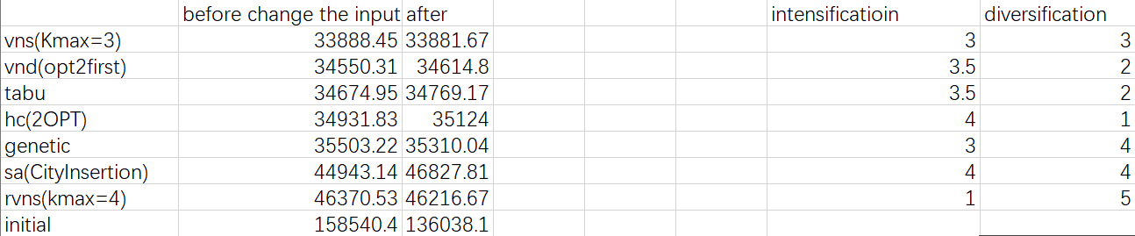
Source Data

Slide 2
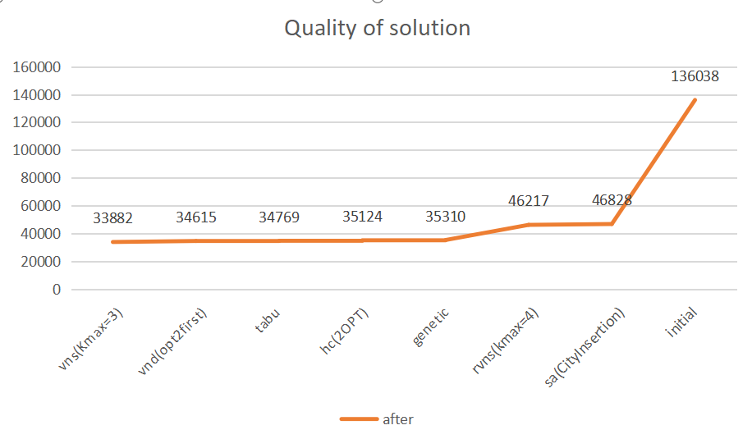
Quality of the Solution

Slide 3
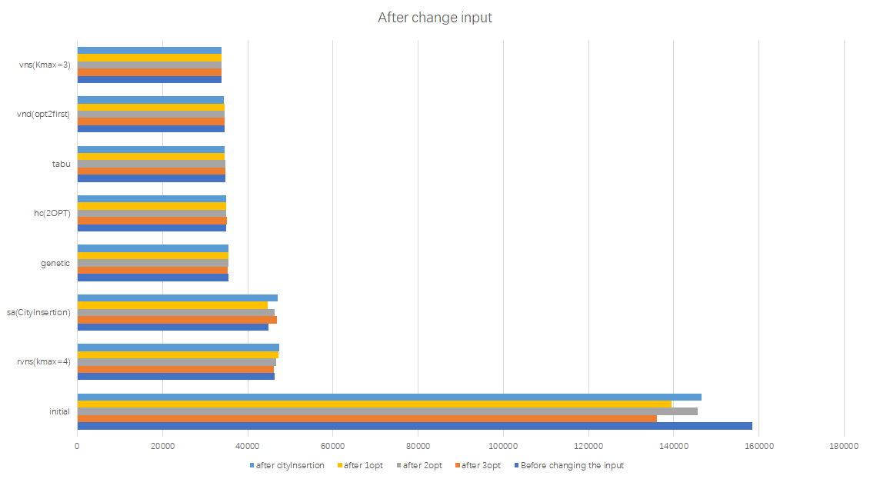

Slide 4
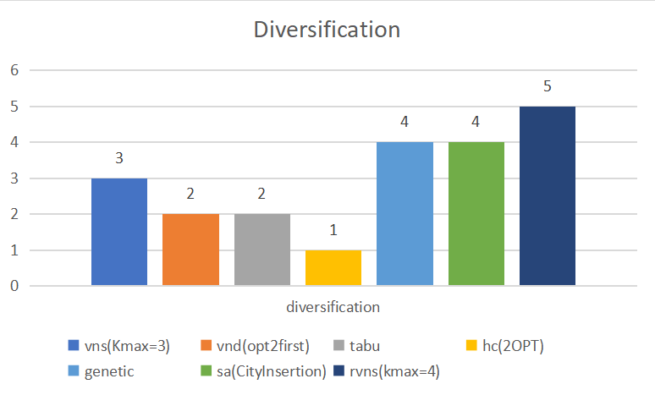
Diversification

Slide 5
Why is diversification in such a way?
VNS-> random choose region and switch neighborhood structure when reaching local minima in the neighborhood
RVNS-> always change the neighborhood structure based on the random solutions, so the solutions can be diffused into different regions, so diversification rate so high.
genetic-> give a fitness function and a group of solution, get rid of the lowest one and do the two-two swaping, ordinary search start from single solution and easy to stick in local minima, but genetic start from a goup, meaning it can compare solution in parallel, convergence time is shorter than others. there is less chance to be diverse.

Slide 6
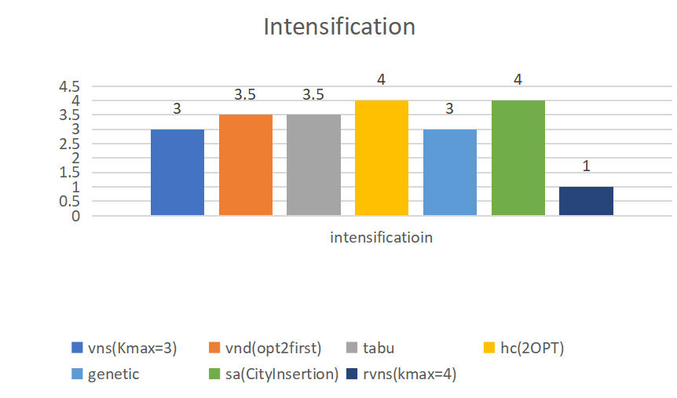
Intensification

Slide 7

Why is intensification in such a way
intensification means search deeper and get optimal result in a short time

Slide 8
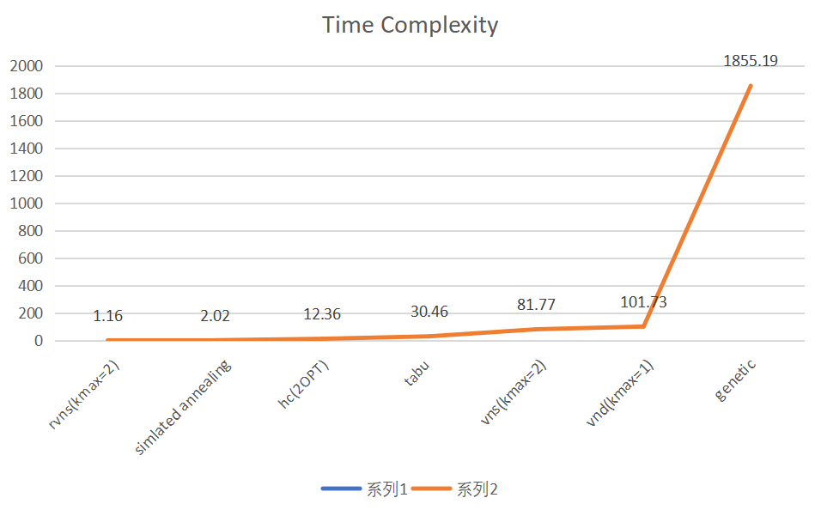
Time Complexity

Slide 9
RVNS using different neighborhood structure

